Slide 1
Template Method Pattern
N. Onur Uzun

Slide 2
What is the Template Pattern?
Define the skeleton of an algorithm in an operation, deferring some steps to subclasses.
Template method lets subclasses redefine certain steps of an algorithm without changing the algorithm's structure.

Slide 3
Motivation
Sometimes you want to specify the order of operations that a method uses, and allow subclasses to provide their own implementations of some of these operations.

Slide 4
Motivation
Each subclass overrides prepareReceipe().
boilWater() and pourInCup() shared by both subclases
MyCafe
prepareReceipe ()
boilWater()
pourInCup()
Coffee
Tea
prepareReceipe ()
brewCoffee()
addSugarAndMilk()
prepareReceipe ()
brewTeaBag()
addLemon()
Notes:
kafey

Slide 5
Motivation
Notice that both recipes follow the same algorithm.
Boil some water
Use the hot water to extract the coffee or tea.
Pour the beverage into a cup.
Add the appropriate condiments to the beverage.
So, we can find a way to abstract prepareReceipe() method.

Slide 6
Motivation
Coffee
Tea
void prepareReceipe(){
boilWater();
brew();
pourInCup();
addCondiments();
}
brewCoffee() and brewTea()
addSugarAndMilk() and addLemon() pretty much same..
void prepareReceipe(){
boilWater();
brewCoffee();
pourInCup();
addSugarAndMilk();
}
void prepareReceipe(){
boilWater();
brewTea();
pourInCup();
addLemon();
}

Slide 7
Motivation
public abstract class MyCafe {
final void prepareRecipe(){
boilWater();
brew();
pourInCup();
addCondiments();
}
abstract void brew();
abstract void addCondiments();
void boilWater(){
System.out.println("Boiling water");
}
void pourInCup(){
System.out.println("Pouring into cup");
}
}
prepareRecipe() is our template method. It serves as a template for an algorithm for making different beverages.
These methods are handled by subclass.
.. and some methods are handled by this class.

Slide 8
Applicability
Use the Template Method pattern:
To implement the invariant parts of an algorithm once and leave it up to subclasses to implement the behavior that can vary.
To avoid code duplication.
To control how subclasses extend superclass operations.
The Template Method is a basic technique for code reuse.

Slide 9
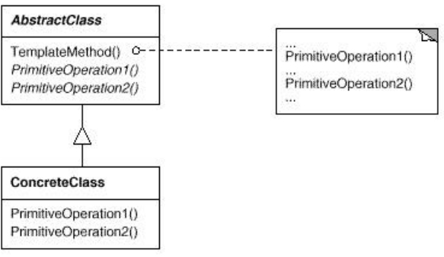
Structure
The ConcreteClass implements the abstract operations, which are called when the TemplateMethod() needs them.

Slide 10
Closer look at the AbstractClass
abstract class AbstractClass {
final void TemplateMethod(){
primitiveOperation1();
primitiveOperation2();
concreteOperation();
hook();
}
abstract void primitiveOperation1();
abstract void primitiveOperation2();
final void concreteOperation(){
// implementation
}
void hook(){ }
}
Template method defines the sequence of steps, each represented by a method.
Two of the primitive operations must be implemented by concrete subclasses.
We can also have concrete methods that do nothing by default, we can call these “hooks” . Subclasses are free to override these but don’t have to.
Notes:
konkriit

Slide 11
Hooked on TemplateMethod
public abstract class MyCafe {
final void prepareRecipe(){
boilWater();
brew();
pourInCup();
if(customerWantsCondiments()){
addCondiments();
}
}
abstract void brew();
abstract void addCondiments();
void boilWater(){
System.out.println("Boiling water");
}
void pourInCup(){
System.out.println("Pouring into cup");
}
boolean customerWantsCondiments(){
return true;
}
}
This gives subclasses the ability to
control the algorithm at various
point. A subclass is also free to ignore
the hook.
This is hook because the subclass can
override this method, but doesn’t have to.

Slide 12
Implementation
Making Coffee and Tea
with same Template Method.

Slide 13
References
Head First Design Patterns
Design Patterns: Elements of Reusable Object-Oriented Software
http://en.wikipedia.org/wiki/Template_method_pattern

